Slide 1
Macroeconomics Review

Slide 2
Federal Reserve
Controls the monetary policy of the US
Can borrow money by selling bonds
Can increase money supply by buying bonds
Serves as the government bank
Supervise and regulate banks

Slide 3
Monetary Policy
Expansionary Policy
The FED increases money supply and decreases interest rates
Consumers prefer to borrow money
Usually lowers loan discount rate (more money encourages growth)
Contractionary Policy
Slow down economic growth and decrease money
Slows inflation (target rate 2%)
Tracks using the CPI

Slide 4
Fiscal Policy
How the government handles taxes
How the government gets and spends its money
Raising taxes, increasing spending, etc.
Balanced budget
Government brings in equal amount as it spends
Deficit
Government spends more than it brings in
Current debt $21 trillion and steadily increasing

Slide 5
Taxes
Regressive tax
Tax rate decreases as taxable income increases
Progressive tax
Tax rate increases as taxable income increases
Types of taxes
Income tax (largest provider for local governments), excise tax, tariffs

Slide 6
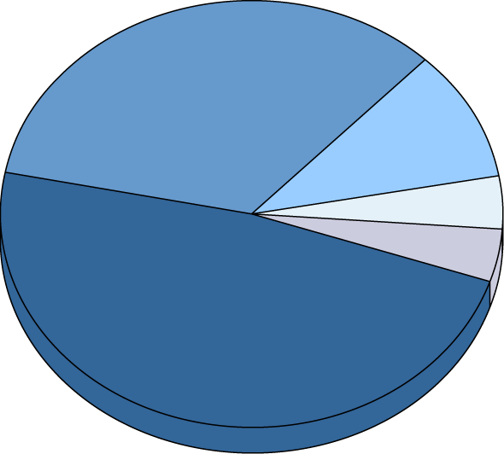
Federal Revenue and Spending: Where It Comes From
Government Spending
Social Insurance
Receipts
34%
Corporate
Income Taxes
10%
Other 4%
Excise Taxes 4%
Individual
Income Taxes
48%
Notes:
The income tax is the most significant means of raising revenue in the
federal government.
Payroll taxes, such as Social Security, Medicare, unemployment, and
other retirement taxes (FICA), account for the second largest source of
federal revenue through taxation.
Excise, estate, gift, and corporate income taxes, as well as customs,
borrowing to cover deficit, and miscellaneous taxes raise the rest of the
revenue needed by the federal government

Slide 7
Banking
Bank
Financial institution that takes deposits from the public and creates credit
In order to be successful a bank must have investors
Credit
The trust which allows one party to loan money to another
FDIC
Created to instill confidence in the banking system
Guarantees up to $250,000 in an individual’s account

