Slide 1
What is Economics????

Slide 2
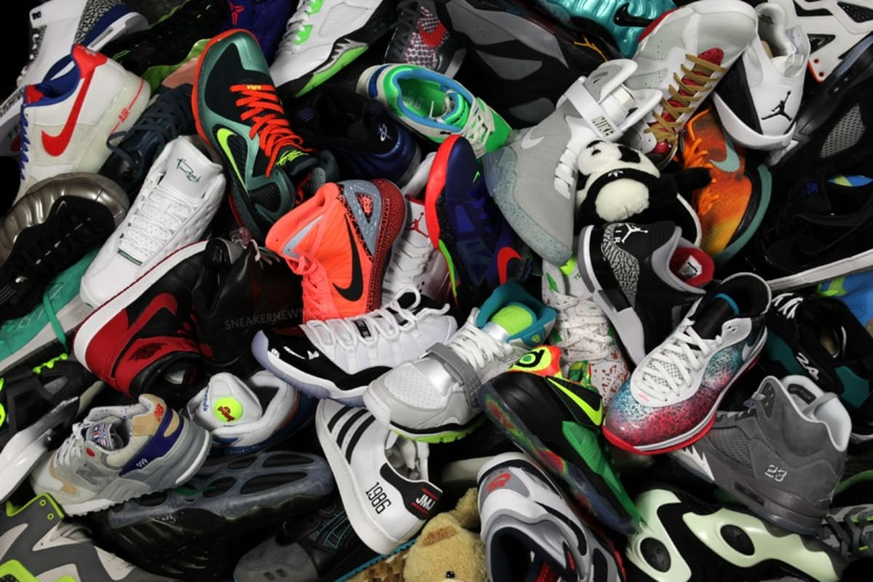
Economics
Economics is the study of how we use our limited resources to meet our unlimited needs and wants

Slide 3
Basic Economic Questions
WHAT good and services to produce
HOW to produce those goods and services
WHO benefits from those goods and services
What is the difference between a good and a service
Good- items that are tangible
Service- activities provided by other people

Slide 4
Answers to those Questions
Consumers
Decide WHAT to buy
Producers
Choose HOW to make it
People with higher incomes
WHO benefit more because they can buy more

Slide 5
Economist
Economist study how people
Produce
Distribute
Consume resources
Use economic models to study specific parts of the economy

Slide 6
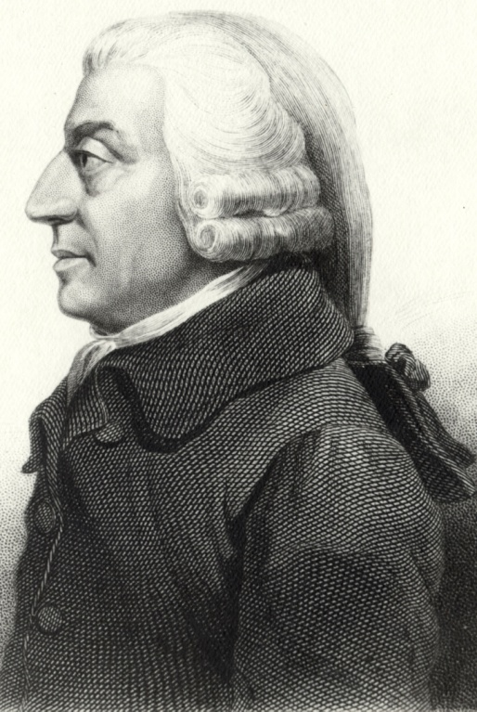
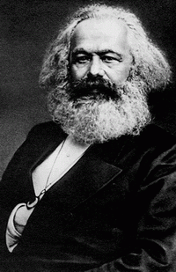
Famous Economist
Adam Smith (1723-1790)
Wrote Wealth of Nations
Free market, Laissez-Faire
Division of labor
Karl Marx (1818-1883)
Socialist, critic of capitalism
Class struggle
Proletariat v. Bourgeoisie

Slide 7
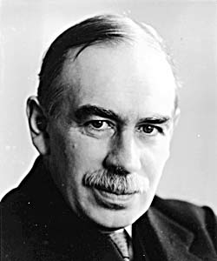
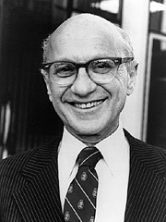
Famous Economists
John Maynard Keyes (1883-1946)
Keynesian Economics
Government hands on in economics
FDR and New Deal
Milton Friedman (1912-2006)
Economic freedom
Laissez faire

Slide 8
Micro vs Macro Economics
Macroeconomics (big picture)
How the overall economy works
Employment, gross domestic product, inflation
Microeconomics (little picture)
How supply and demand interact in markets

Slide 9
Scarcity
Scarcity is not being able to have everything you want
There are not enough resources and products to satisfy us:
Our wants and needs are unlimited
Resources however are limited
Consumers, businesses and governments must make choices
Known as Trade-offs
Opportunity Cost

Slide 10
Supply and Demand

Slide 11
Demand
Demand
The desire, willingness and ability of people to buy products
Individual demand
How many goods a single person is willing to buy at any price
Market demand
How many goods all people are willing to buy

Slide 12
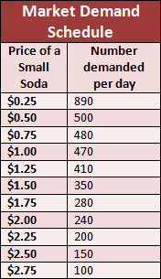
Demand Schedule
Table that list the number of a product someone is willing to buy over several possible prices

Slide 13
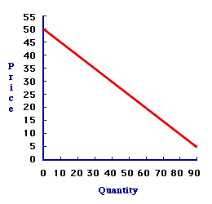
Demand Graph
Showing a demand schedule as points on a graph
Graph list prices on the vertical axis and quantity on the horizontal
Demand curve is the line that connects these points

Slide 14
Law of Demand
As the price of an item rises and other factors remain unchanged the quantity demanded will fall
Utility: the pleasure, usefulness or enjoyment we get from using a product

Slide 15
determinants of Demand
Changes in population
Changes in income
Changes in taste
Changes in expectations
Product related changes
Changes in the price of related goods
Substitutes: products that can be used in place of each other
Complimentary: products used together

Slide 16
Principle of Diminishing Marginal Utility
Each additional unit of a product is less valuable than the one before it
As long as BENEFIT exceeds COST people are better off doing more
If COST exceeds the BENEFIT people are better off doing less

Slide 17
# COOKIES | MARGINAL BENEFIT
1 | WOW! YUMMY! DELICOUS!
2 | STILL TASTY!
3 | PRETTY GOOD
4 | I HAVE STOPPED LICKING MY FINGERS
5 | THE GUILT IS SETTING IN
6 | ITS GETTING TOUGH TO SHOVE IT IN
7 | THEY DON’T LOOK SO APPEALING
8 | ANYONE HAVE SOME TUMS
9 | PEPTO-BISMAL PLEASE
10 | CALL MY MOTHER!! I’M GONNA BE SICK!

Slide 18
Supply

Slide 19
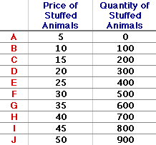
Supply
Supply
Ability and willingness of suppliers to make things available for sale at set prices
Law of Supply
As the price of an item rises the quantity supplied will rise, as prices drop so will the supply
Supply schedule
Chart showing the amount of an item sellers are willing to sell at various prices

Slide 20
Changes in Supply
Supply can change just as demands, curve shifts right if supply goes up and left if it goes down
Based on cost
Changes in supply are based on the cost of production
If they can reduce cost then they will produce more
Changes in cost of resources
Changes in productivity and/or technology
Change in government policy
Changes in taxes and subsidies

Slide 21
Changes in Supply
Increase in Supply (Outward Shift) Right
P
S₁
S₂
$3
13
18
Q

Slide 22
Changes in Supply
Decrease in Supply (Inward Shift) Left
P
S₃
S₁
$3
9
13
Q

Slide 23
A Change in Supply
If the market price for gasoline is $2.00 a gallon, the supply curve for gasoline S₁ indicates Q₁ units would be supplied.
Price (dollars)
S₂
S₁
$2.00
If the price fell to $1.50, the quantity supplied would fall to Q₂ units (where Q₂ < Q₁).
$1.50
If, somehow, the production costs for gas manufacturers changed then the supply of gas would change.
$1.00
Consider the case where the cost of crude oil (an input in gasoline production) increases.
Q₃
Q₂
Q₁
Quantity (units of gasoline per year)
The supply of gasoline at all potential market prices would fall. Now at $1.50, Q₃ units are supplied (where Q₃ < Q₂ < Q₁).

Slide 24
Elasticity of Supply
Supply Elastic
Producers offer more goods as prices rise
Ex: goods that require little investment/ money to increase production (candy)
Supply Inelastic
Producers don’t change amounts offered very much as price change
Ex: goods that need a lot of money for production (oil)

Slide 25
Types of Businesses

Slide 26
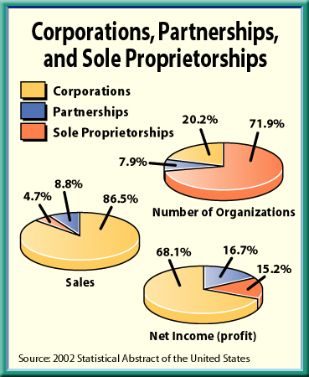
Business Organizations
Sole proprietorship
Partnership
Corporation

Slide 27
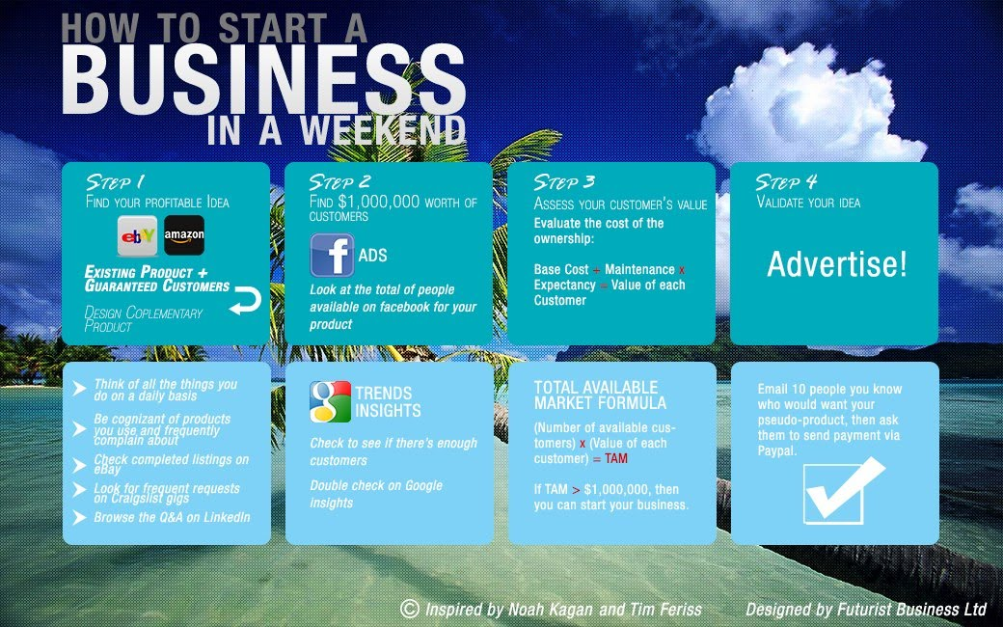
Starting a business
Business plan
Business license

Slide 28
Sole Proprietorships
Business owned and run by one person
Easiest form of business to start
Strengths
Relatively easy to manage
Enjoy profits without having to share
Personal freedom
Weaknesses
Unlimited liability
Difficult to raise money
Limited life

Slide 29
Partnership
Business jointly owned by two or more
General partnership
All partners responsible
Limited partnerships
Contributes funds
Articles of Partnership
Details responsibilities, roles and profit sharing

Slide 30
Partnership
Strengths
Easy to start
Easier to get start up money
Lager in size; more efficient
Pay no corporate income tax
Weakness
Unlimited liability
Limited life
Potential for conflict between partners

